Slide 1



OPAL Tools
Free Tools for Oracle Software Development
Dietmar Aust Opal-Consulting, Cologne
www.opal-consulting.de

Slide 2
Agenda
WHY? Background / Context
The Solution
Demo
Customization
Download / GitHub

Slide 3
WHY? Background / Context
Notes:
Drag your picture and Send to Back

Slide 4
WHY? Background / Context
These tools are part of my effort to remove myself from active project work and collaborate with partners and their teams.
Standardized project structure, documentation, methods and tools lead to transparency and productivity
Easy to move people from one project to another
Also, I like clarity and structure
Took the time to automate and streamline things
It is FUN ☺

Slide 5
WHY? Background / Context
20+ years of custom development for Oracle: PL/SQL, SQL, Forms, Reports, APEX, have seen very different approaches
Typical project has multiple environments, e.g.:
Development
Test
Production
… or even more
Manage sources differently
SQL and PL/SQL objects (1:1 in database)
„Manual“ scripts (e.g. alter table add column or generate synonyms, grants and views on the fly)

Slide 6
WHY? Background / Context
Different people use different workflows
The database is the master – with or w/o version control
The file system is the master – typically with version control
A mix of the two (working alone most of the time and/or forgot to use the file). Easy synchronization would be nice.
Different projects – different tools
Cannot rely 100% on a specific tool
Most tools don‘t work well on the command line (either calling and/or customizing them)

Slide 7
The Solution
Notes:
Drag your picture and Send to Back

Slide 8
The Solution
The software:
Written in Java + (generated) batch scripts
Works on Windows, MacOS and Linux
Exporter leverages DBMS_METADATA and SQLcl
Installer leverages SQLcl
Tools can be used together … OR separately
Java application opal-export
Java application opal-install
DBMS_METADATA
SQLcl
SQLcl

Slide 9

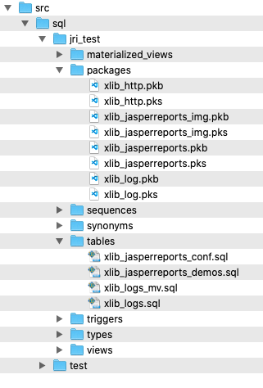
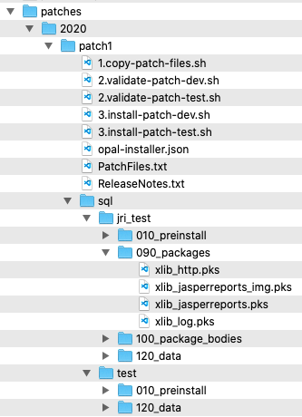
The Solution
Source Files
Patches
install
Test
Export with
DBMS_METADATA
copy files
or
reference files
e.g. @../packages/util.pks
Development
install
Export:
Database Objects
APEX applications
ORDS modules
Custom spool scripts
Patch / Deployment:
SQL scripts
Executed with SQLcl
Production
Patch Installation can be automatically registered

Slide 10
The Solution
Tools can be used together … or separately
Exporter – Use Cases:
Initial seed of database objects into the file system
Continuous export of database objects
Goal? Seamless integration
Don‘t force a specific approach, rather support existing styles and improve the quality
No point in having a PERFECT approach that isn‘t widely used.

Slide 11
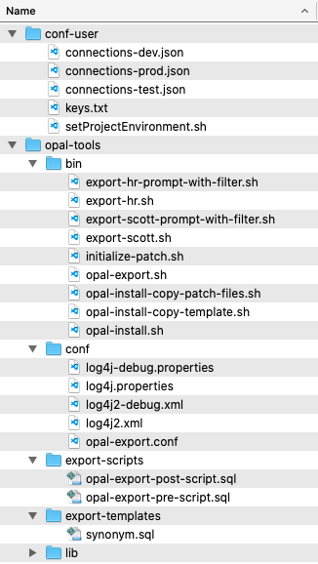
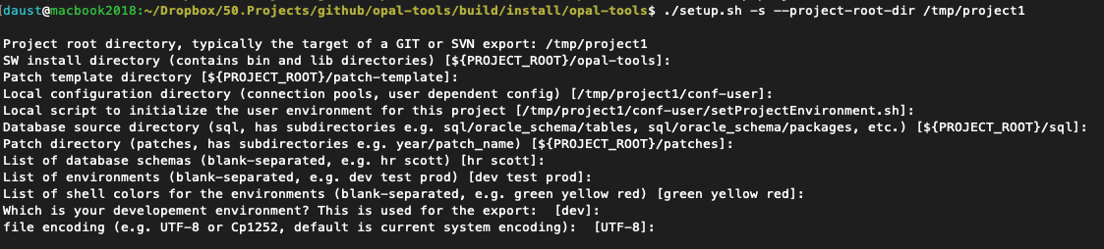
The Solution
E.g. run setup for schemas HR and SCOTT and environments dev,test,prod
Folder „conf-user“
Typically outside of GIT / SVN repository

Slide 12
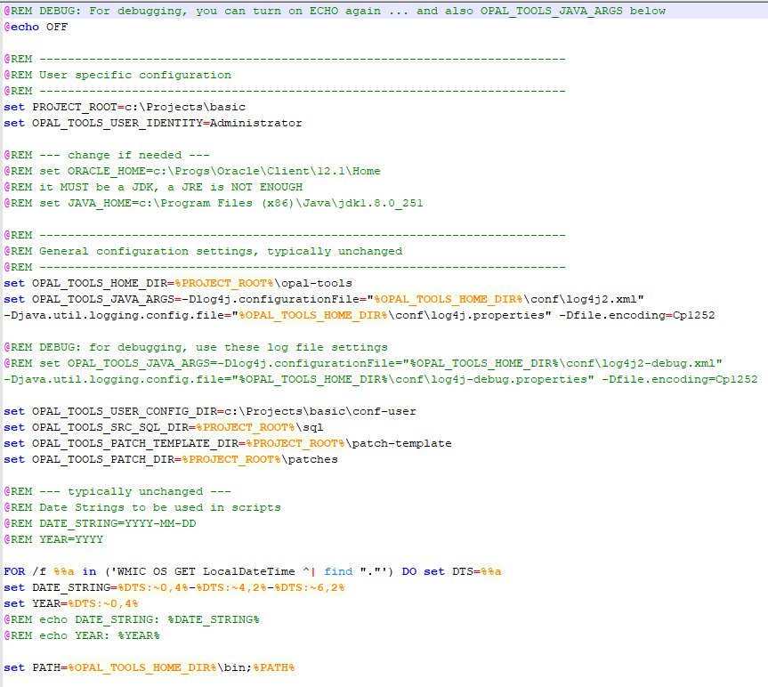
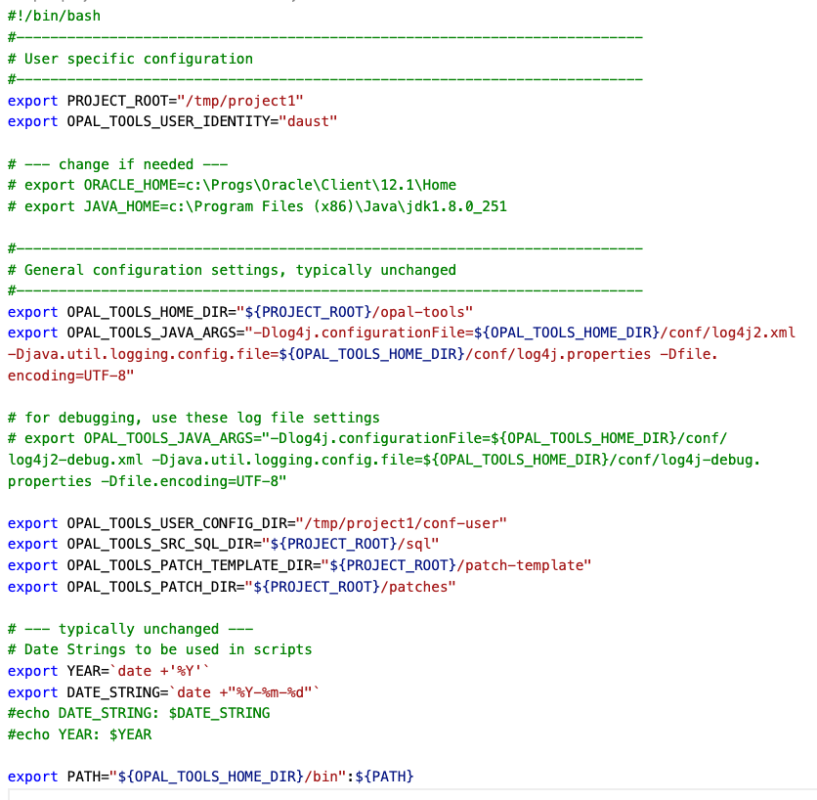
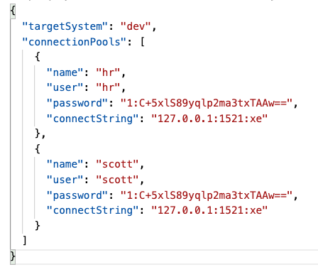
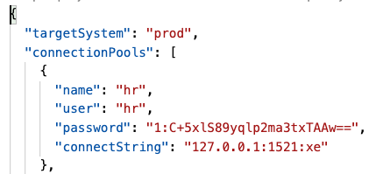
The Solution
setProjectEnvironment.sh / cmd
connections-dev.json
Support for:
Proxy Accounts
Cloud Database
connections-prod.json

Slide 13
The Solution
Folder „opal-tools/bin“
Contains scripts to call the Java programs
Contains generated scripts for each database schema

Slide 14
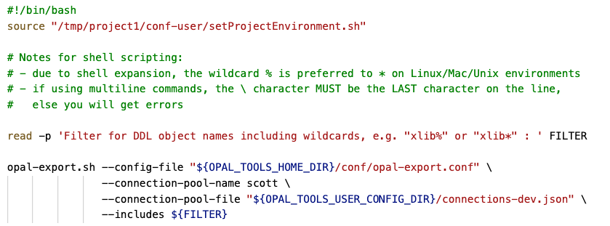
The Solution - EXPORT
opal-export.sh
simple wrapper for the Java application
export-scott-prompt-with-filter.sh
calls setProjectEnvironment.sh first
Prompts for like-filter of db objects
Uses the connection pool for the development environment

Slide 15
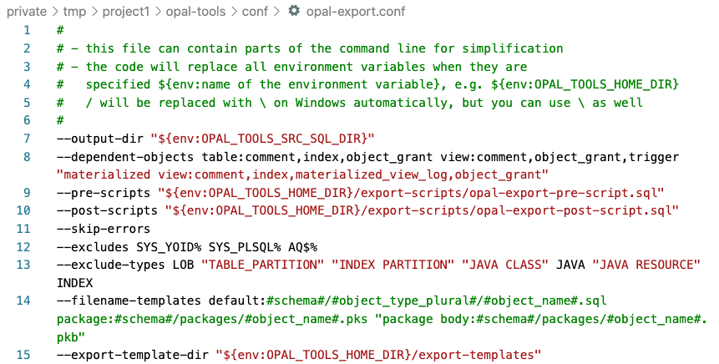
The Solution - EXPORT
Folder „opal-tools/conf“
Config files for the logging
Config file for global settings

Slide 16
The Solution - EXPORT
Folder „opal-tools/export-scripts“
Run before or after exporting the DDL for the selected objects

Slide 17
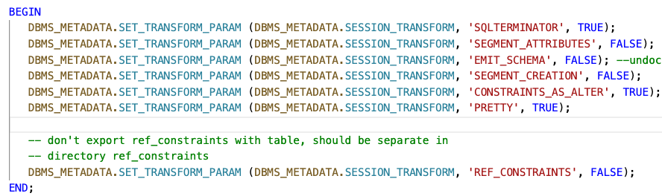
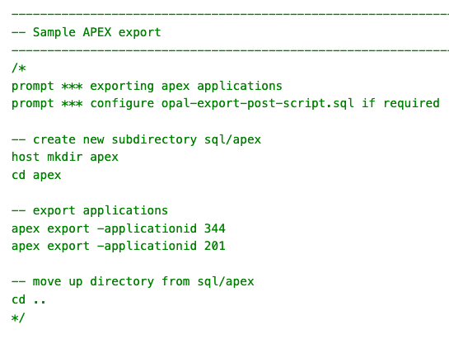
The Solution - EXPORT
opal-export-pre-script.sql
opal-export-post-script.sql

Slide 18
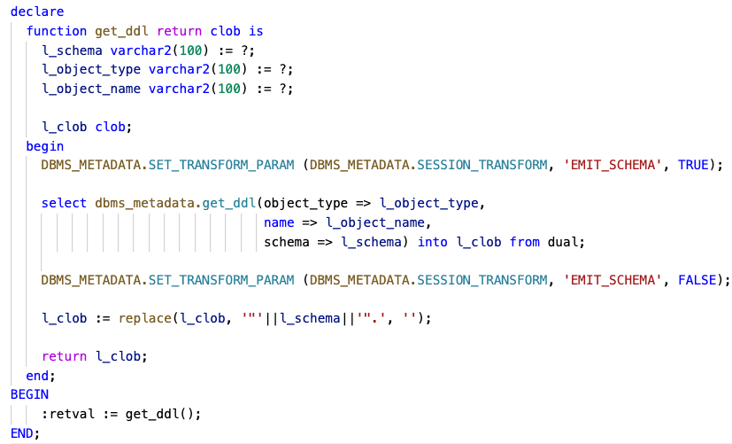
The Solution - EXPORT
Folder „opal-tools/export-templates“
Override the general call to dbms_metadata.get_ddl()

Slide 19
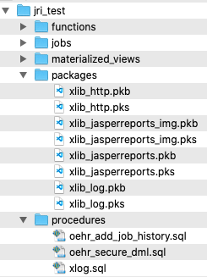

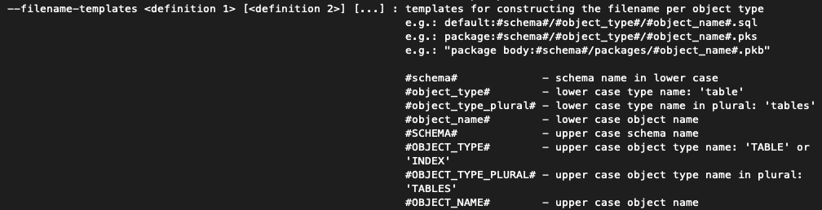
The Solution - EXPORT
Folder „sql“
Export of database object into files

Slide 20
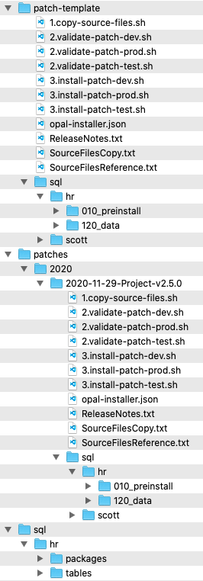
The Solution - INSTALLER
Folder „patch-template“
Will be used as a template for a new patch (copy directory and subdirectories)
Folder „sql“
sql source files
Folder „patches“
<year>/<year-month-day>-<patch name> is generated through the batch script initialize-patch.sh

Slide 21
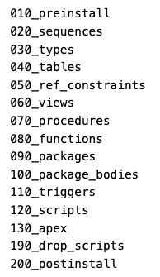
The Solution - INSTALLER
Iterate through folder tree and execute files
Connection pool is chosen based on regular expression of the file path
Scripts are organized in folders to minimize errors (dependencies / compilation)

Slide 22
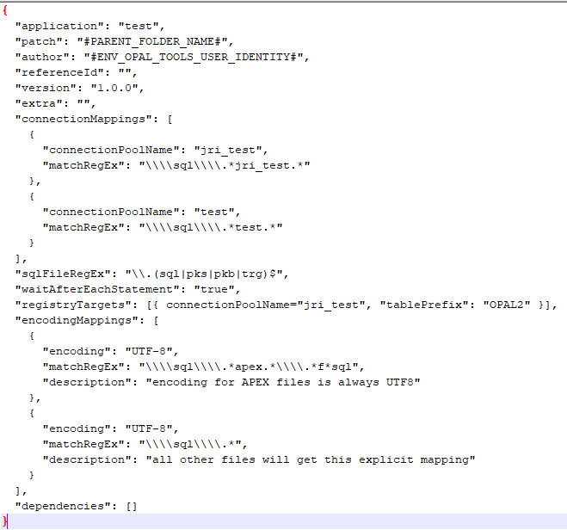
The Solution - INSTALLER
Config file for the patch: opal-installer.json

Slide 23

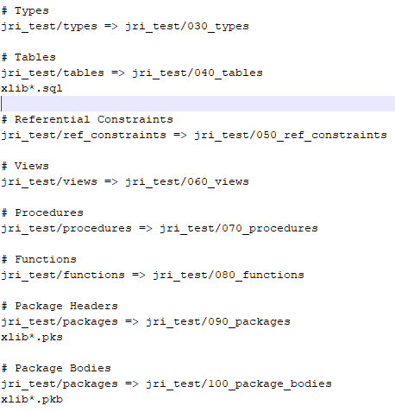
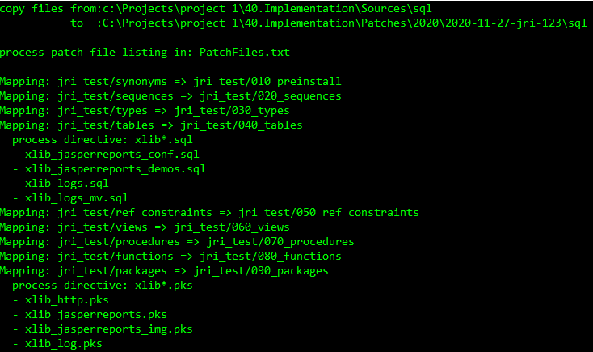
The Solution - INSTALLER
1.copy-source-files.sh
Copies files from the source tree to a target tree

Slide 24
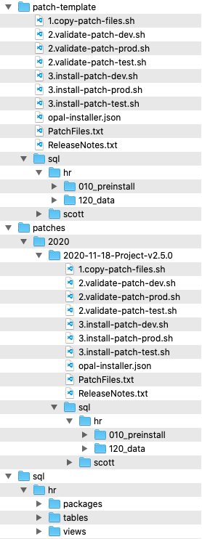
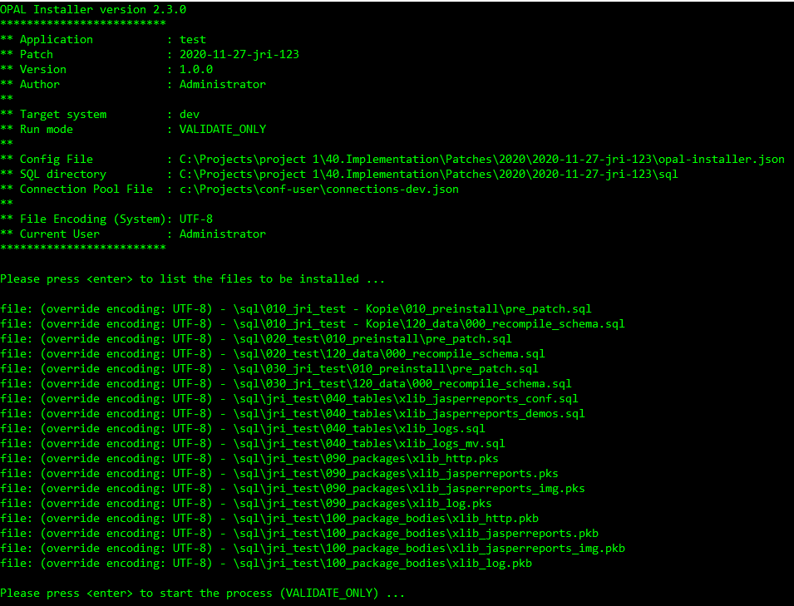
The Solution - INSTALLER
2.validate-<environment>.sh
Validates connection pool and shows files in the order they will be installed

Slide 25
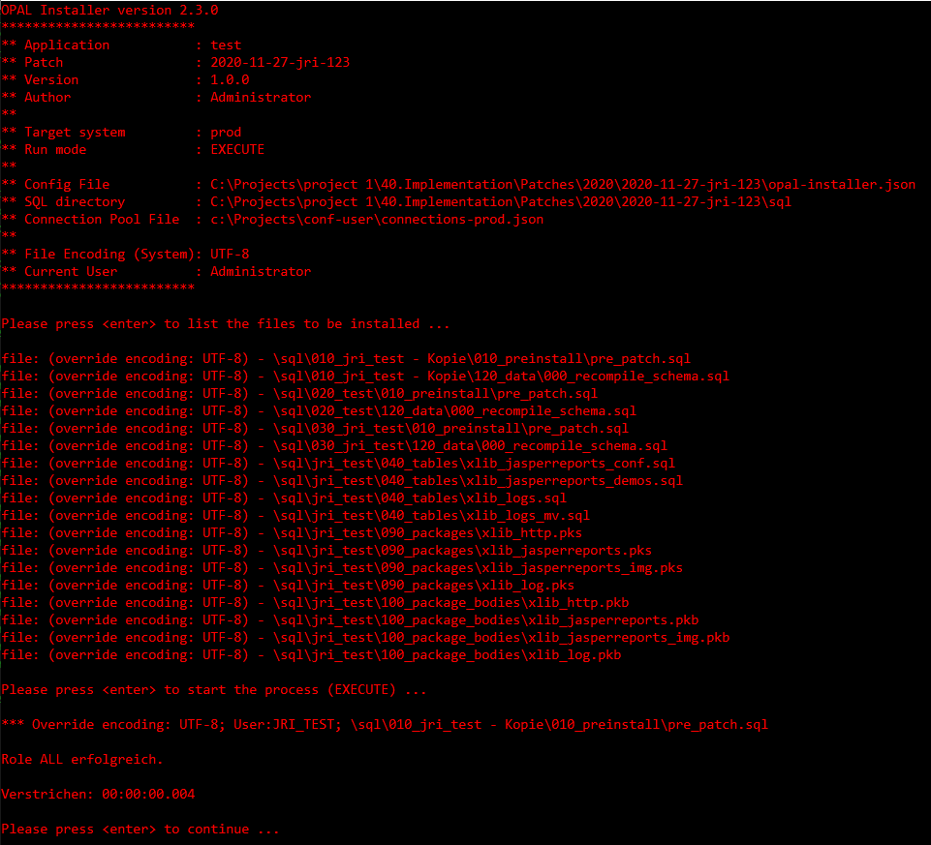
The Solution - INSTALLER
3.install-<environment>.sh

Slide 26

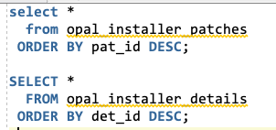
The Solution - INSTALLER
ReleaseNotes.txt
Plain text file
When it exists, will be inserted into patch table

Slide 27
Demo
Notes:
Drag your picture and Send to Back

Slide 28
Customization
Notes:
Drag your picture and Send to Back

Slide 29
Customization
EVERYTHING should be customizable
No approach is forced, no directory layout is assumed
Shell scripts are pre-generated, can and should be adapted to your needs
Patches are based on the patch-template folder, make changes there
Everything is driven by command-line switches

Slide 30
Download / GitHub
Notes:
Drag your picture and Send to Back

Slide 31
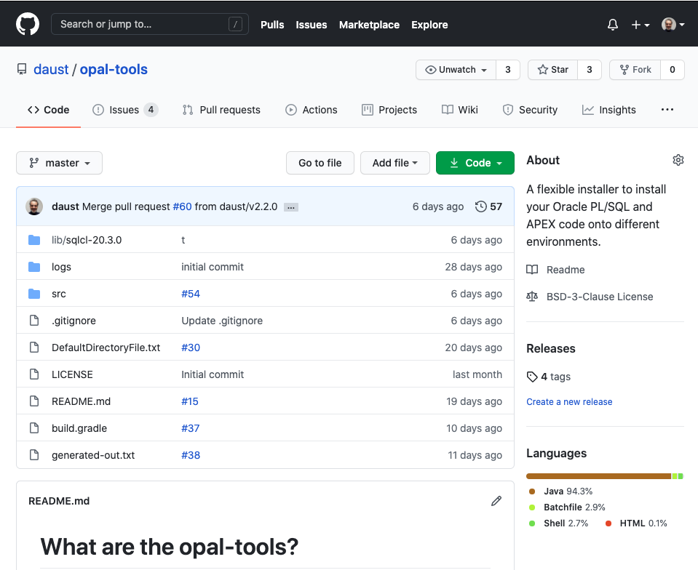
https://github.com/daust/opal-tools

Slide 32
Questions?
Opal Consulting
Email / Website
Zum Tilmeshof 11
50859 Köln
Germany
dietmar.aust@opal-consulting.de
www.opal-consulting.de

